Slide 1
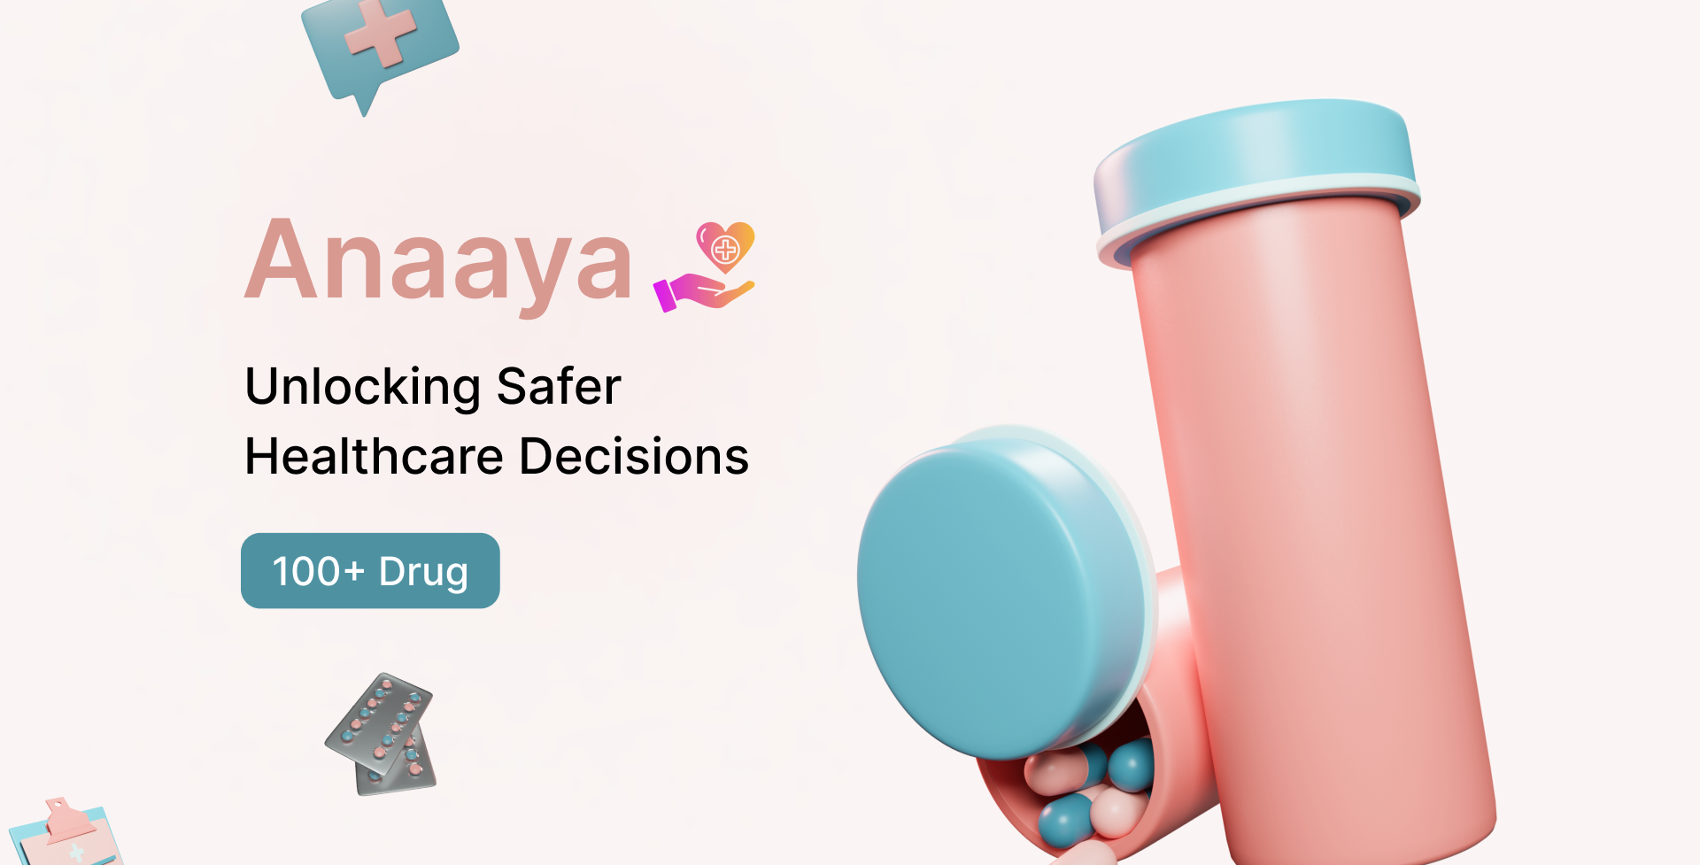



Slide 2

TEAM: AiMl
Mai A. Shaaban
Adnan Khan
Ph.D. Machine Learning @ MBZUAI
M.Sc. Computer Science
Mobile App Developer
Ph.D. Computer Science @ Carleton
M.Sc. Computer Vision
Machine Learning Researcher
Page | 1

Slide 3
PROBLEM
Adverse Drug Reaction (ADR) is harmful unintended reaction caused by a medicine
ADRs are caused by:
Incorrect diagnosis
Inappropriate drug prescription
ADR is a leading cause of deaths in many countries [1]
It varies from patient to patient and depends on factors such as patient history
Currently, physicians fail to determine which drug can cause ADR for me, or you..!
[1] - WHO, Briefing Note Safety of medicines – adverse drug reactions
Page | 2

Slide 4
STATISTICS
2,216,000
4th
TOTAL
CAUSE OF DEATH
106,000
DEATHS
ADRs in hospitalized patients
Ahead of pulmonary disease, diabetes, AIDS, pneumonia, accidents, and automobile deaths
Fatality rate of 0.32% in hospitalized patients
Page | 3
Reference: FDA

Slide 5
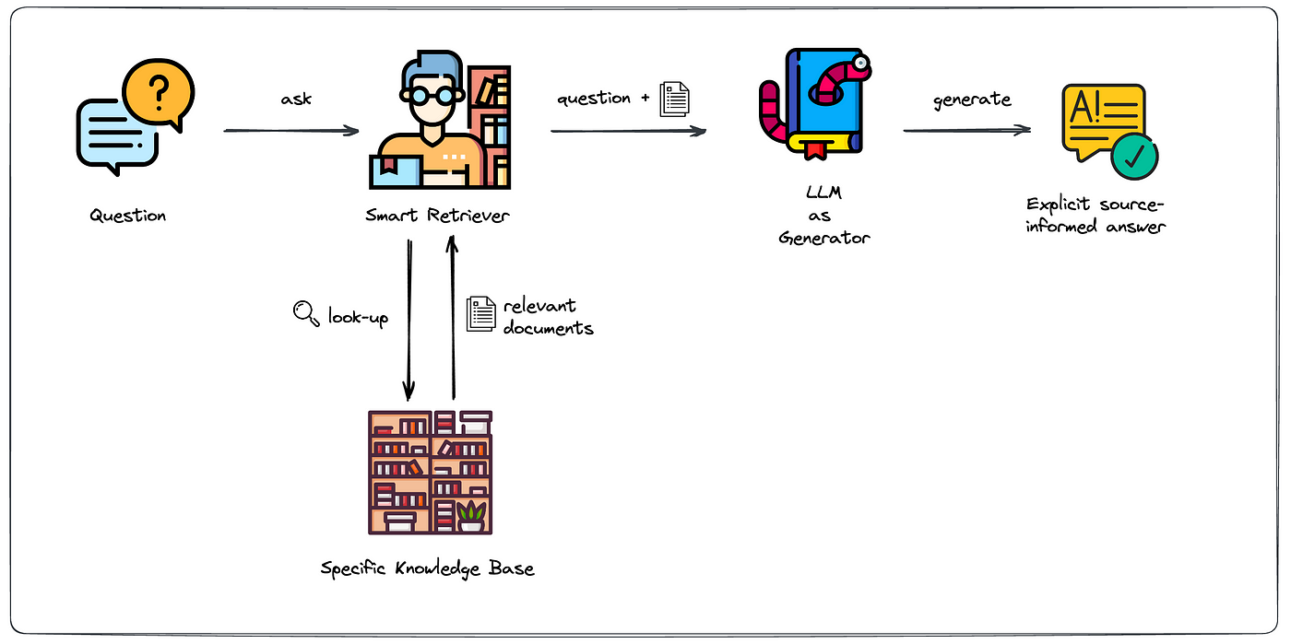
SOLUTION
Anaaya, a chatbot for clinicians that can inform them about the potential ADR of a prescribed drug based on the patient's history
Anaaya uses Retrieval Augmented Generation (RAG)
Personalized
Known source of information
Up-to-Date information
Based on the regions
[1]
[1] - https://blog.ml6.eu/leveraging-llms-on-your-domain-specific-knowledge-base-4441c8837b47
Page | 4

Slide 6


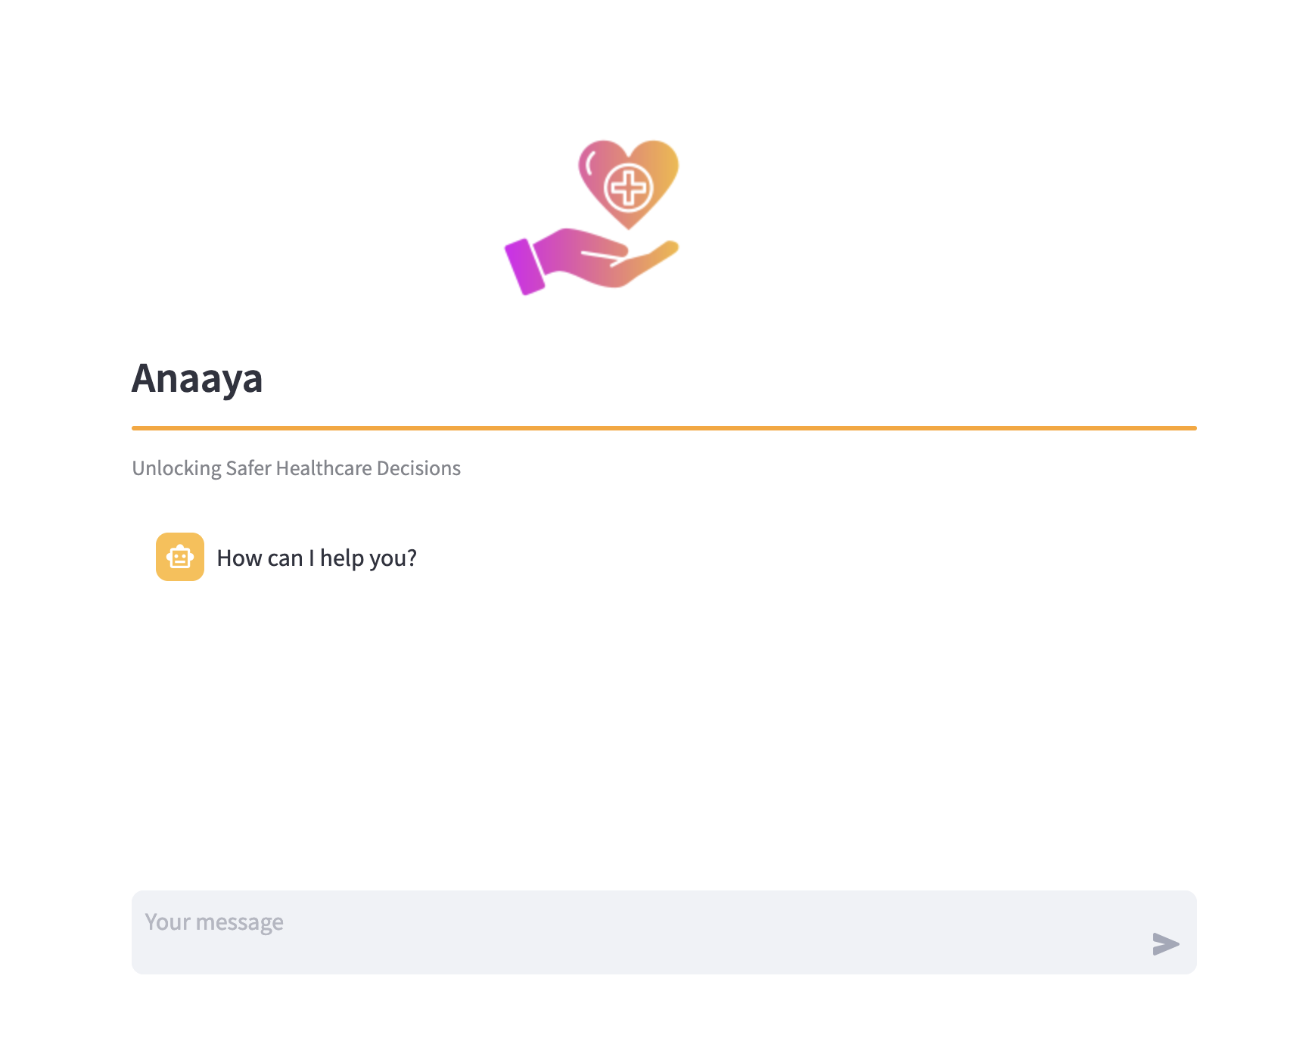




SCHEMATIC DIAGRAM
Embeddings Creation
Object Storage
Vector DB
Q
API Call
A
Large Language Model
I have a patient with anaphylaxis, should I give penicillin?
Context Retrieval
Platform for AI
Client-side
Server-side
Page | 5

Slide 7

KNOWLEDGE BASE
To enrich the knowledge base, we have different resources mentioned below:
Publicly available datasets:
SIDER 4.1: Side Effect Resource [1]
Kaggle: Drugs, Side Effects and Medical Condition [2]
Private datasets from healthcare providers
[1] - http://sideeffects.embl.de
[2] - https://www.kaggle.com/datasets/jithinanievarghese/drugs-side-effects-and-medical-condition
Page | 6

Slide 8
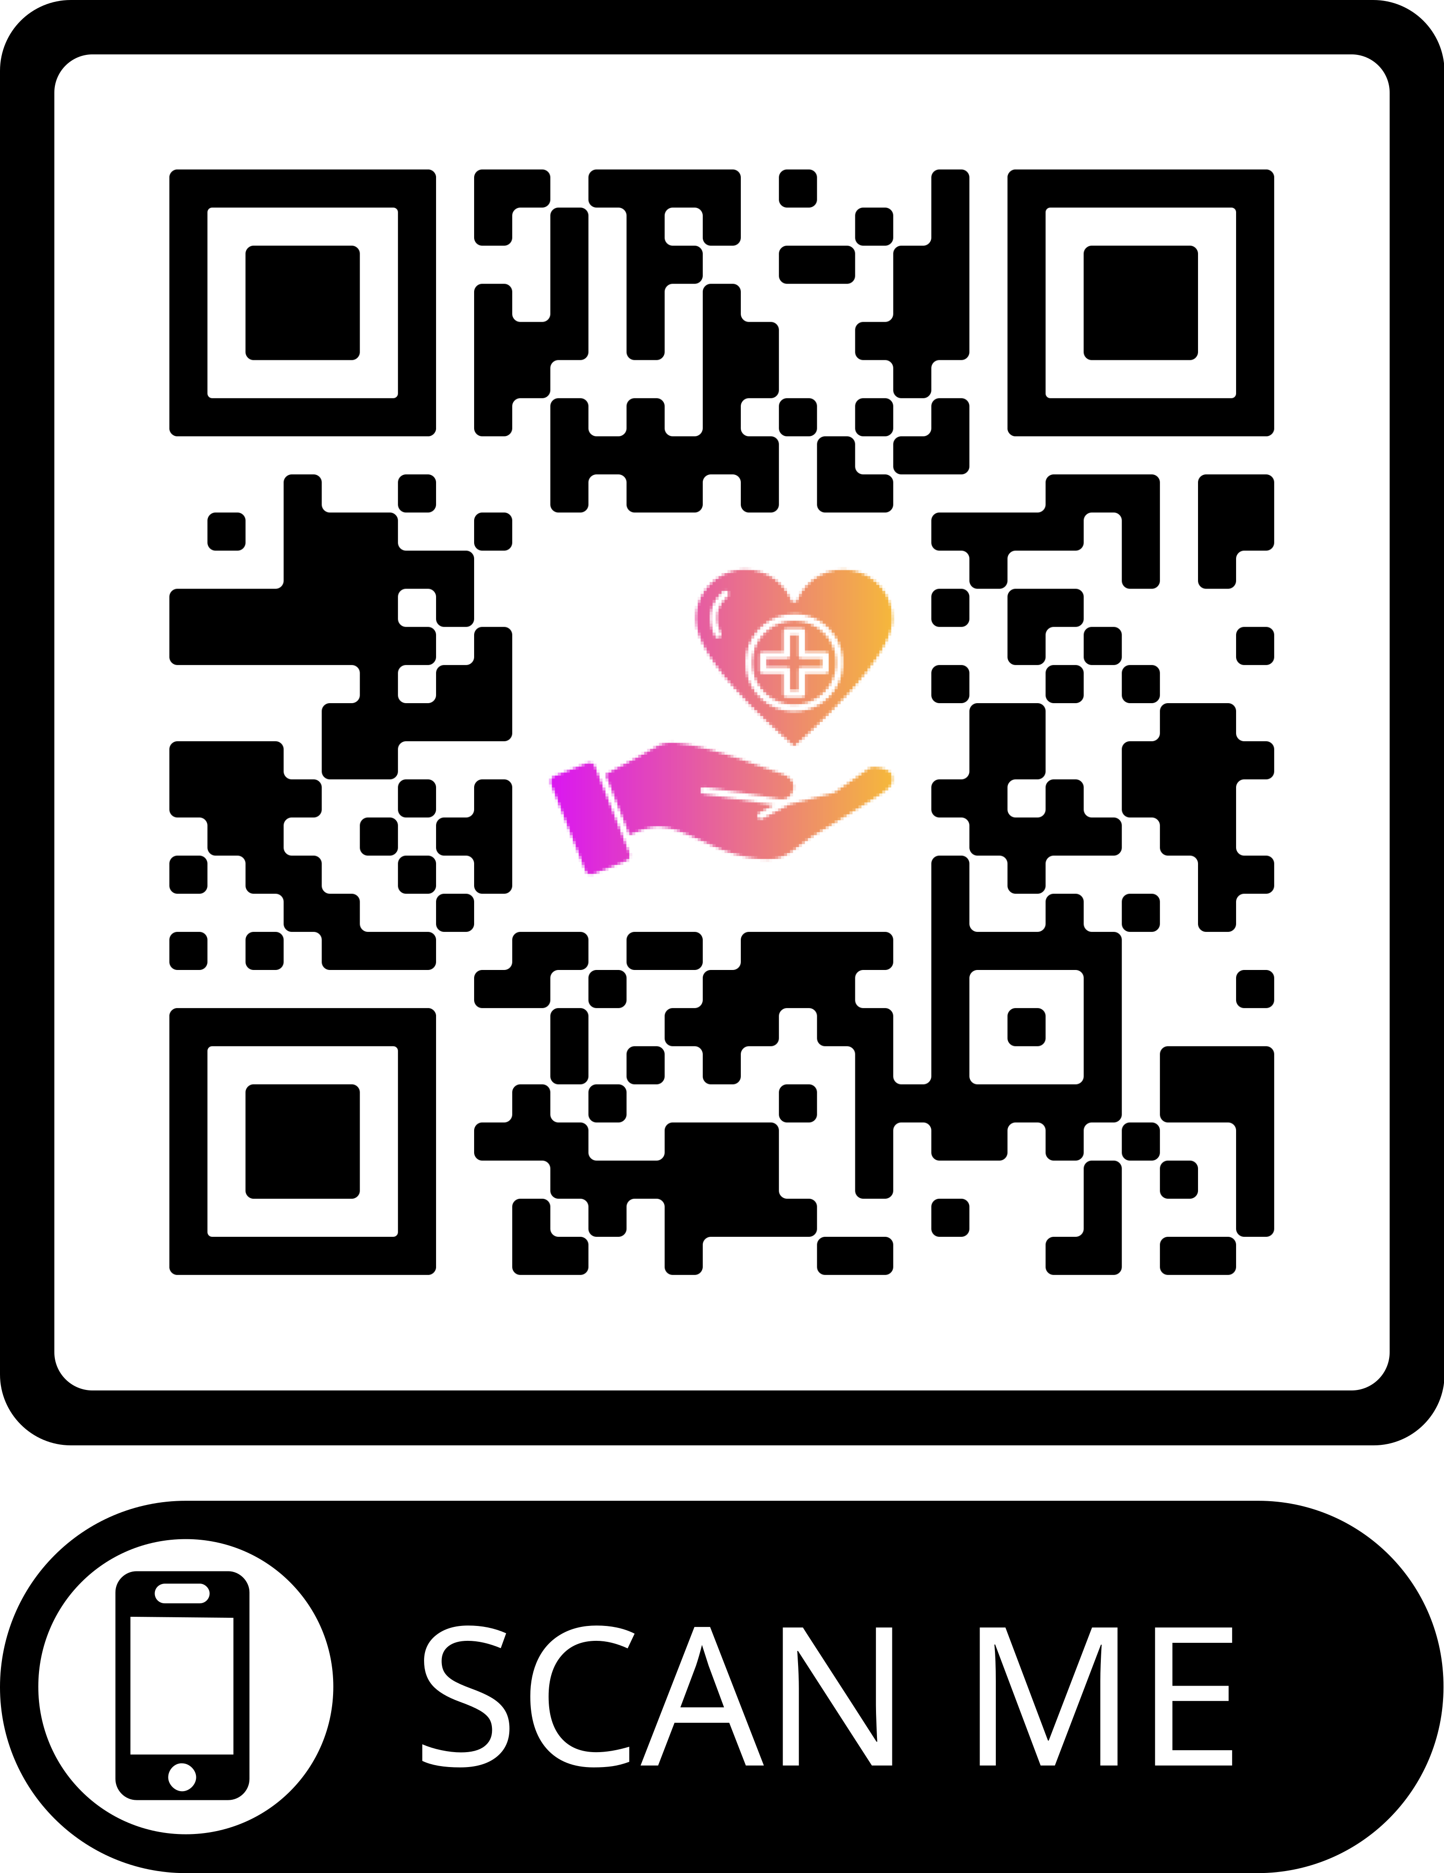
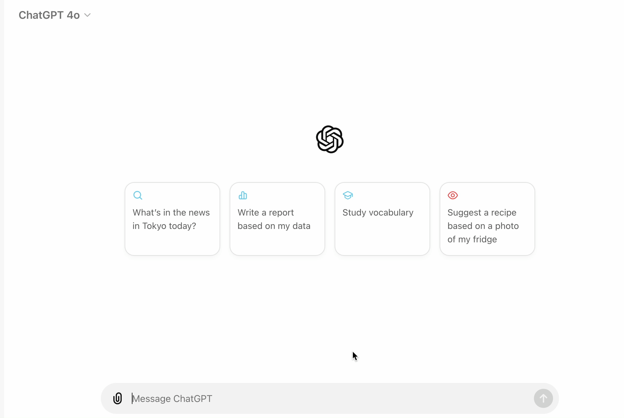
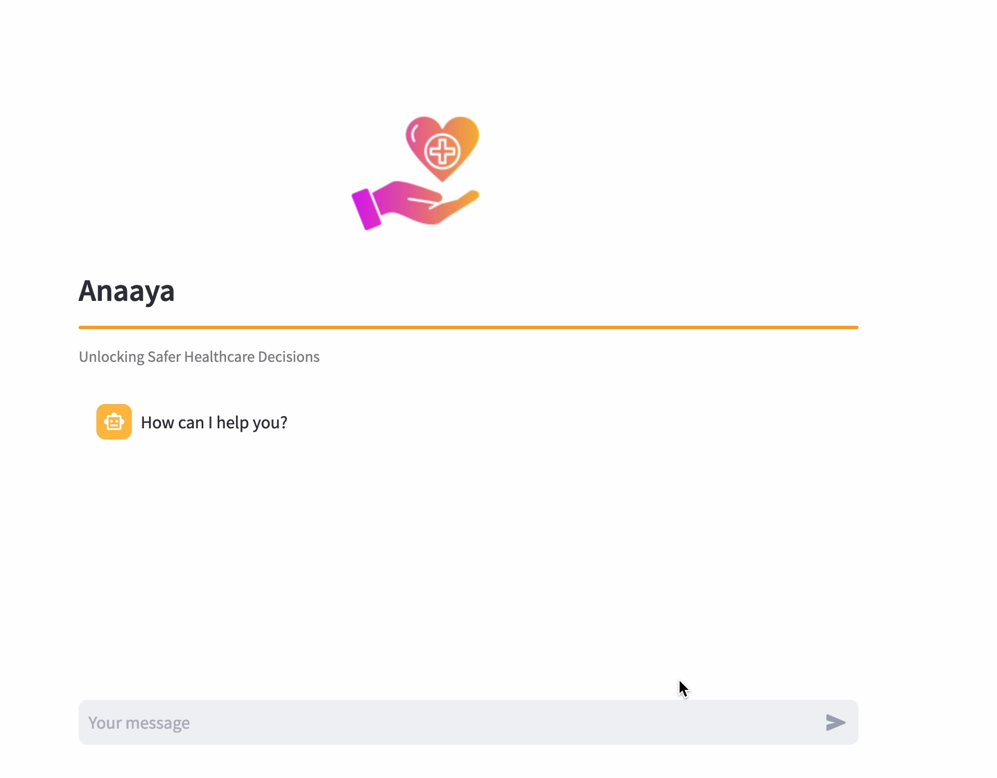
DEMO
Competitors
Anaaya
Page | 7
Play the videos for viewing the demo
Notes:
General side effects, but ours is more specific, accurate, customized to the patient history condition.

Slide 9





TECHNOLOGIES
MindsDB
Together AI
LangChain
AI Platform
Open-source Models
LLM Framework
Llama 3.1
Streamlit
Large Language Model
User Interface Solution
Page | 8
Notes:
We used MindsDB for web crawling data about drugs and side affects.
Together AI for accessing open-source llms (it is like huggingface)
LangChain for implmeneting RAG system (indexing and document retrieval)
Streamlit: UI integration

Slide 10
VALUE PROPOSITIONS
ADR Expertise
With a deep understanding of adverse drug reactions (ADRs), Anaaya is your clinicians' ADR encyclopedia. Backed by AI expertise, it goes the extra mile to ensure safe and effective patient care
Precision isn't just a goal; it's our commitment. The cutting-edge technology and personalized insights ensure the right drug, for the right patient, at the right time. Every time.
Precise
Easy
Designed for clinicians, with simplicity in mind. Engage in natural, intuitive conversations with the chatbot to access ADR insights effortlessly.
Page | 9

Slide 11
SWOT ANALYSIS
S
W
O
T
STRENGTHS
WEAKNESSES
AI Technology
Personalization
Known Source of Information
Up-to-Date Information
Regional Consideration
Quantity and Quality of Data
Data Privacy and Security
OPPORTUNITIES
THREATS
Scalability
Telemedicine Integration
Research Collaboration
Data Accessibility
Resistance to Change
Page | 10

Slide 12

FUTURE WORK
Data Quality Improvement
Privacy and security measures
Integration and Adoption
Scalability
Telemedicine Integration
User-Friendly Interface
Feedback Loop
Page | 11

Slide 13
BUSINESS MODEL
Value
Cost Structure
Patient safety & Compliance
Data security & Resources
Customer Segments
Revenue Streams
Healthcare Providers/Clinics
Subscription Model
Page | 12

Slide 14
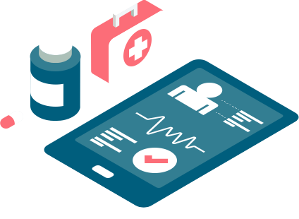
WRAP-UP
Anaaya is the first ADR chatbot that is driven by cutting-edge AI, ensures that every medication decision aligns with the patient history and allergies, reducing risks, and enhancing care.

Slide 15
Thanks
Reach out if you have questions
mai.kassem@mbzuai.ac.ae

